Slide 1
River Navigation Image Guidance

Slide 2
Stevens Eyot Upstream

Slide 3
Kingston Railway Bridge Upstream

Slide 4
Kingston Road Bridge Upstream

Slide 5
Ravens Ait
Upstream

Slide 6
Turn at Hampton Court
Anticipated position of turn buoy
If there is an overlap heading into the turn (on reaching the flag on the right-hand bank) the crew that is ahead has priority and other craft must give way. (Safety Rule 7)

Slide 7
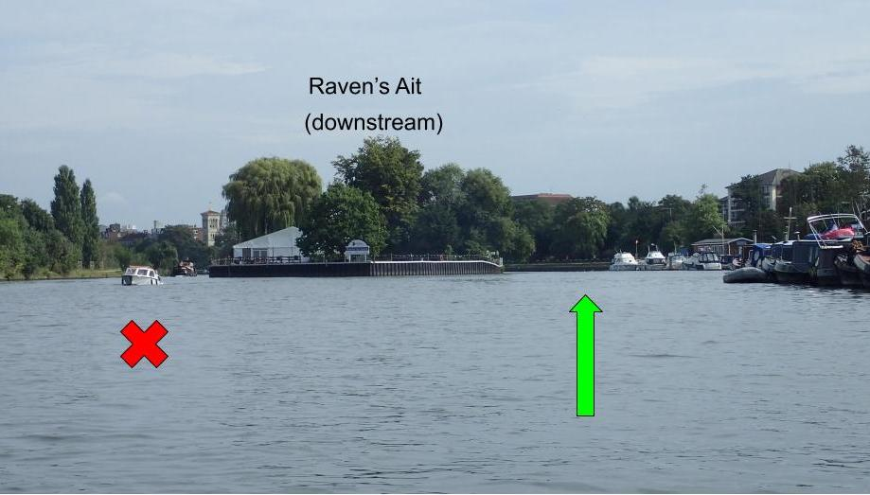
Ravens Ait
Downstream

Slide 8
Kingston Road Bridge Downstream

Slide 9
Kingston Rail Bridge Downstream

Slide 10
Continue on the left of the river after island to the canoe club within the channel marked for the race. Sailing boats and other river traffic will all be on the right of the river
Stevens Eyot
Downstream

Slide 11
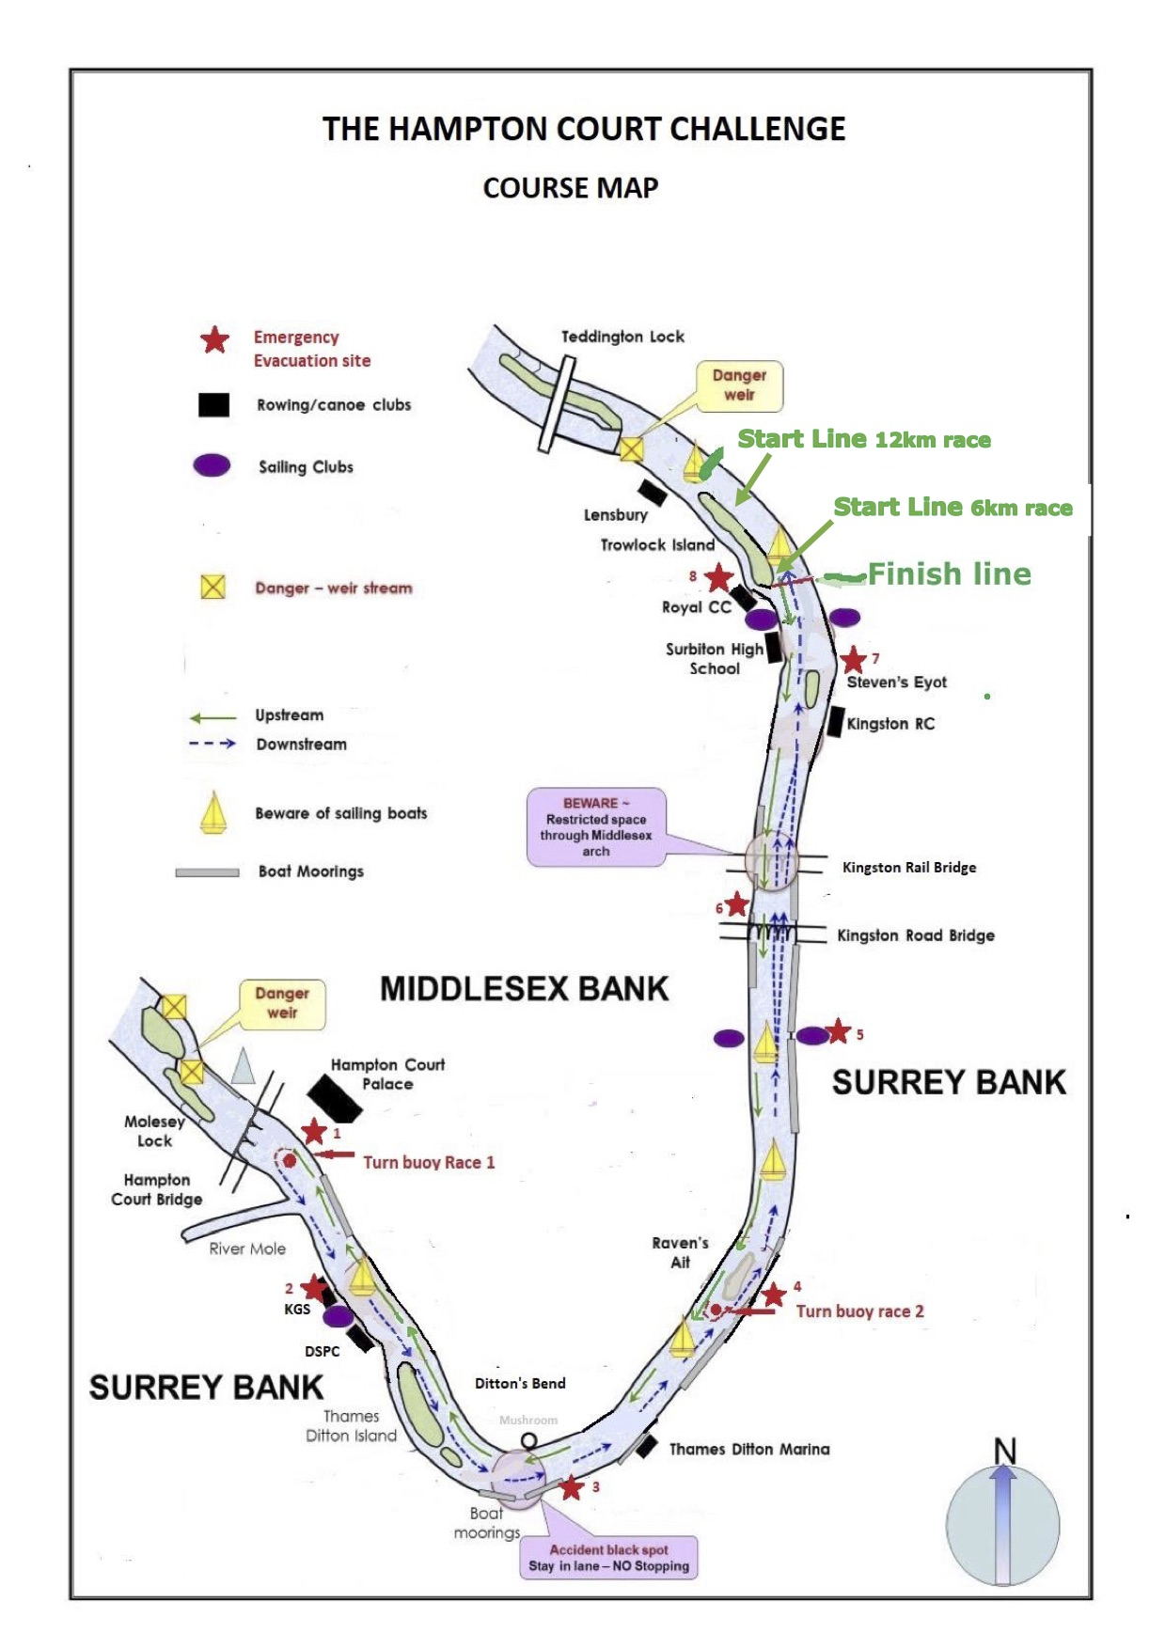
Turn buoy Race 2

